Slide 1


Adversarially Learned Anomaly Detection using Generative Adversarial Networks
Master of Science thesis - Şemsi Yiğit Özgümüş
School of Industrial and Information Engineering
Master of Science in Computer Science and Engineering
Academic Year 2018 - 2019
Candidate: Şemsi Yiğit Özgümüş
Supervisor : Giacomo Boracchi
Notes:
Hello everyone, my name is Yiğit Özgümüş and today I will be presenting you my thesis
“Adversarially learned Anomaly Detection Using Generative Adversarial Networks”.

Slide 2


What is Anomaly Detection ?
Samples that don’t follow the characteristic behaviors of the defined notion of normality
Cyber security
Finance
Healthcare
Manufacturing
1
Master of Science thesis - Şemsi Yiğit Özgümüş
Notes:
I would like to start by defining what anomaly detection is.
Anomaly detection is finding samples that don’t follow the characteristic behaviors of the defined notion of normality
Notion of normality is discovered by means of modeling the available data.
Finding anomalies in data may translate into usable and actionable information that may be beneficial for variety of application domains
Such as cybersecurity, finance, healthcare and manufacturing.

Slide 3
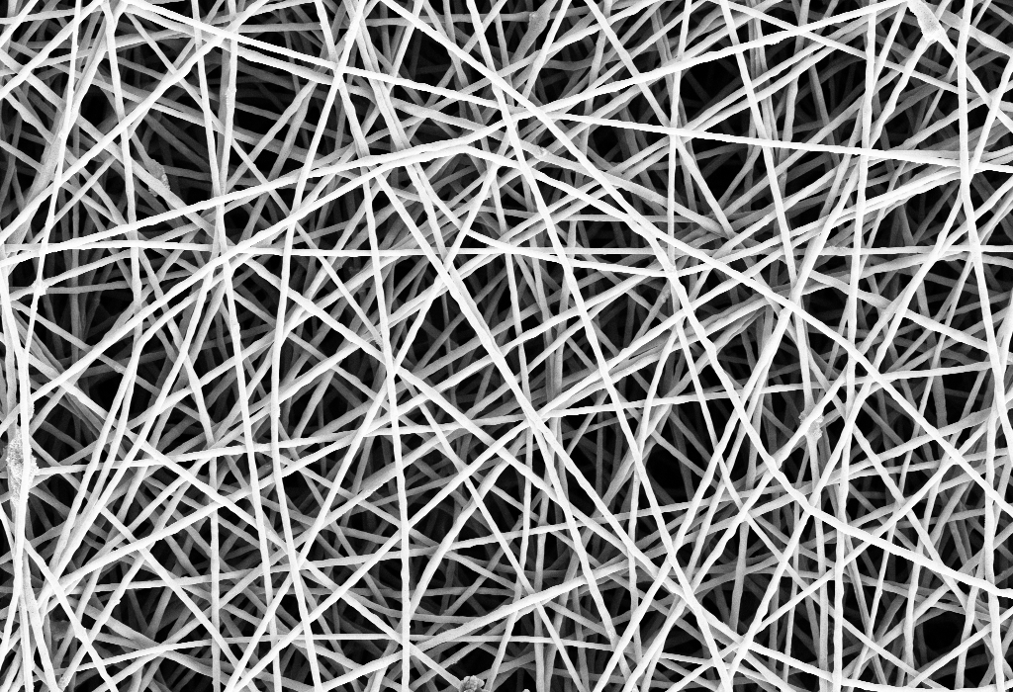
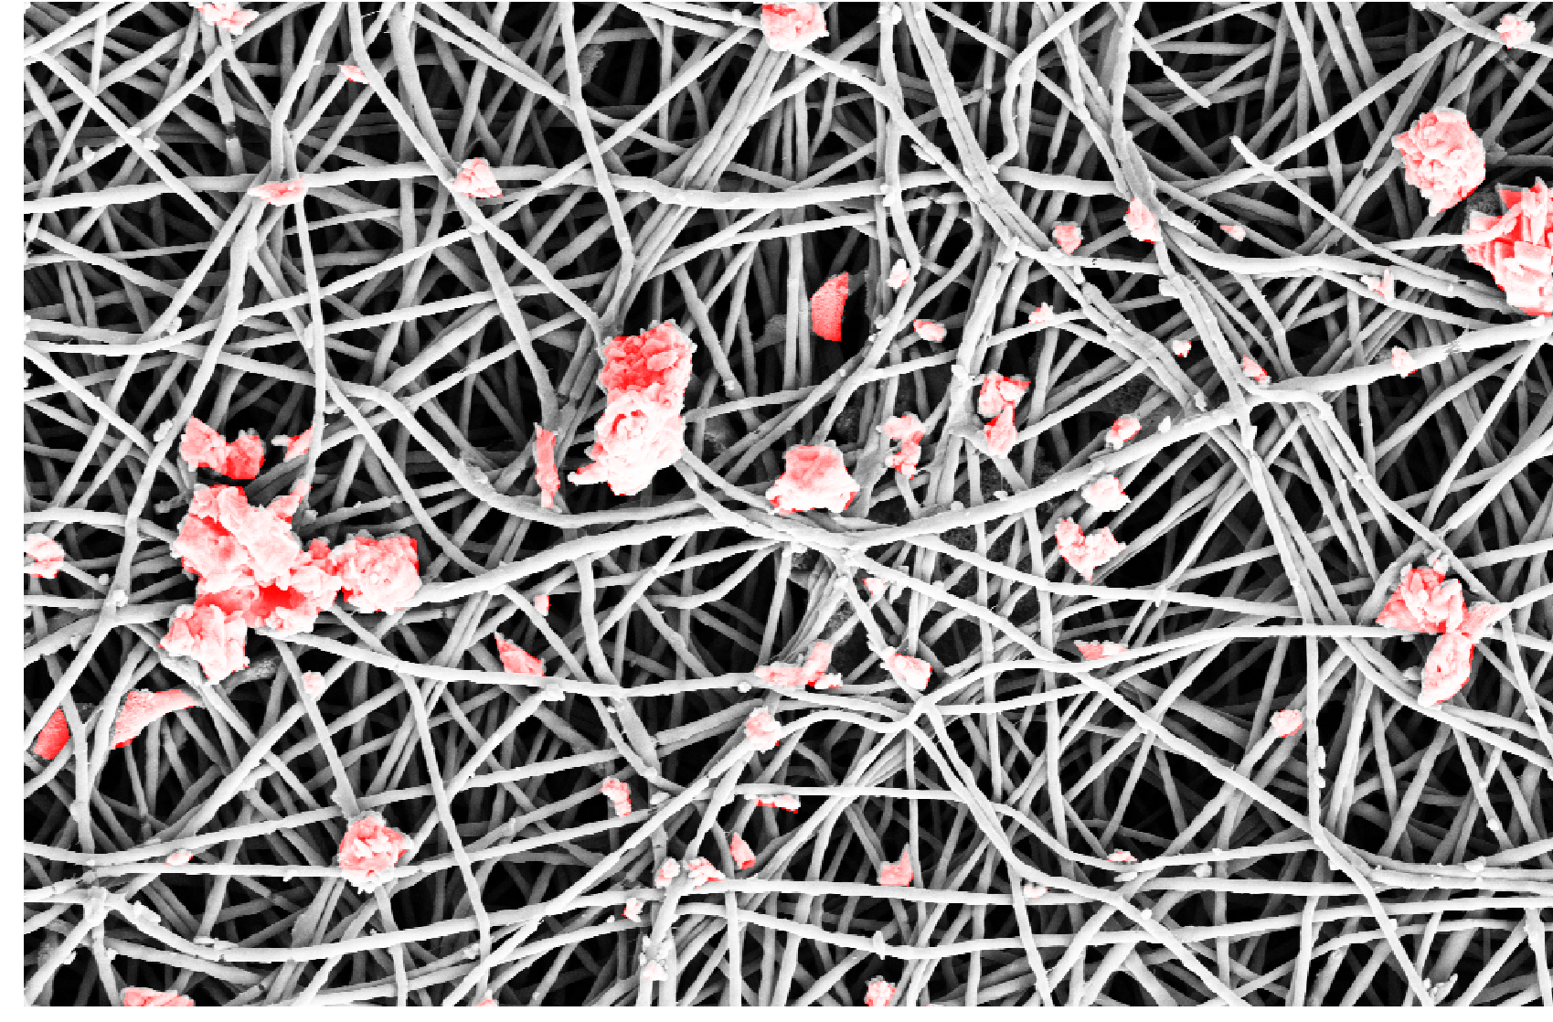
Problem focus of This Thesis
Nanofibrous material production monitoring
Detection of defective regions occurred in the production process due to external factors
Detection of anomalies are required to monitor quality of batches and to prevent waste
2
Master of Science thesis - Şemsi Yiğit Özgümüş
POLITECNICO DI MILANO
Notes:
The problem this thesis investigates is the anomaly detection in nanofibrous material production.
Due to the sensitivity of the production process, anomalous regions with various shapes and sizes may be formed between the filaments.
Detection of these anomalies are required
to maintain a certain quality standard in production line
and also to prevent waste of materials.
To give an example,

Slide 4
Problem focus of This Thesis
Location Detection of Anomalies
3
Master of Science thesis - Şemsi Yiğit Özgümüş
POLITECNICO DI MILANO
Notes:
This is an image with various types of anomalous regions.
As you can see, Anomalies have no defining characteristics
İn terms of shape and size.
Our aim is to detect the locations of these anomalies

Slide 5
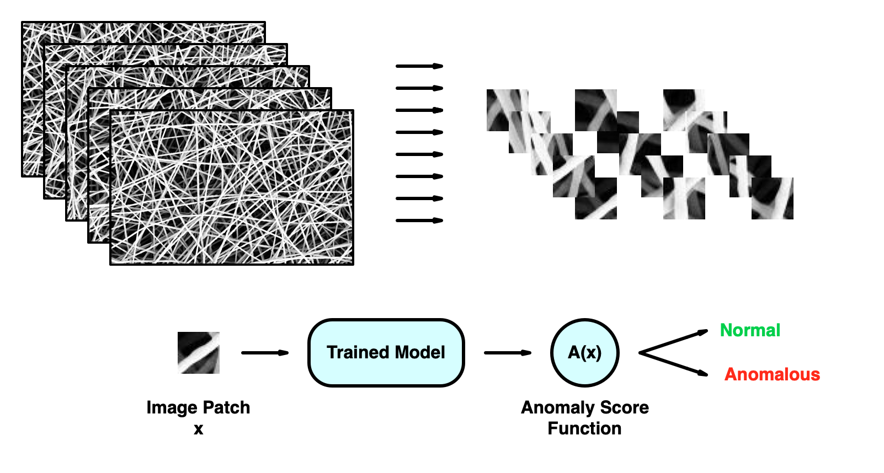
Problem focus of This Thesis
Image Patches
Normal Data
4
Master of Science thesis - Şemsi Yiğit Özgümüş
POLITECNICO DI MILANO
Notes:
For this reason, we work with image patches instead of whole images.
Our Model is trained only with normal data.
Using an anomaly score function and our trained model, we determine whether a patch contains anomalous region or not.

Slide 6
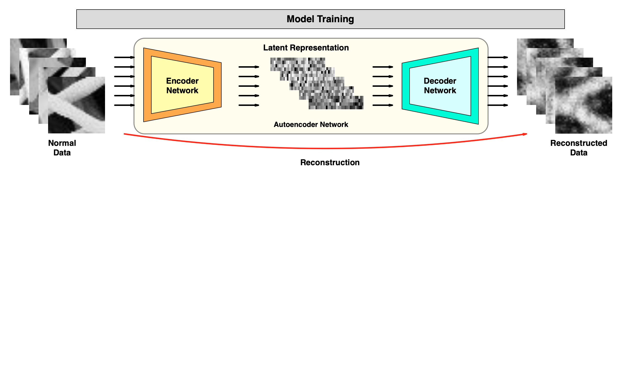
Reconstruction Based Anomaly Detection
Mapping from image space to latent dimension space
Reconstruction from latent representation
Computing score from the information loss
5
Master of Science thesis - Şemsi Yiğit Özgümüş
POLITECNICO DI MILANO
Notes:
Because we are using only normal data to train our model, we prefer to use reconstruction based anomaly detection.
Autoencoder networks are heavily used for this anomaly detection method.
Autoencoders consists of an encoder and decoder network.
Encoder maps the high dimensional data to a latent space and decoder reconstructs data from this latent representation.
They are trained in a way to minimize the difference between the actual sample and its reconstruction
so that learned latent representation contains the most salient features of the image.

Slide 7
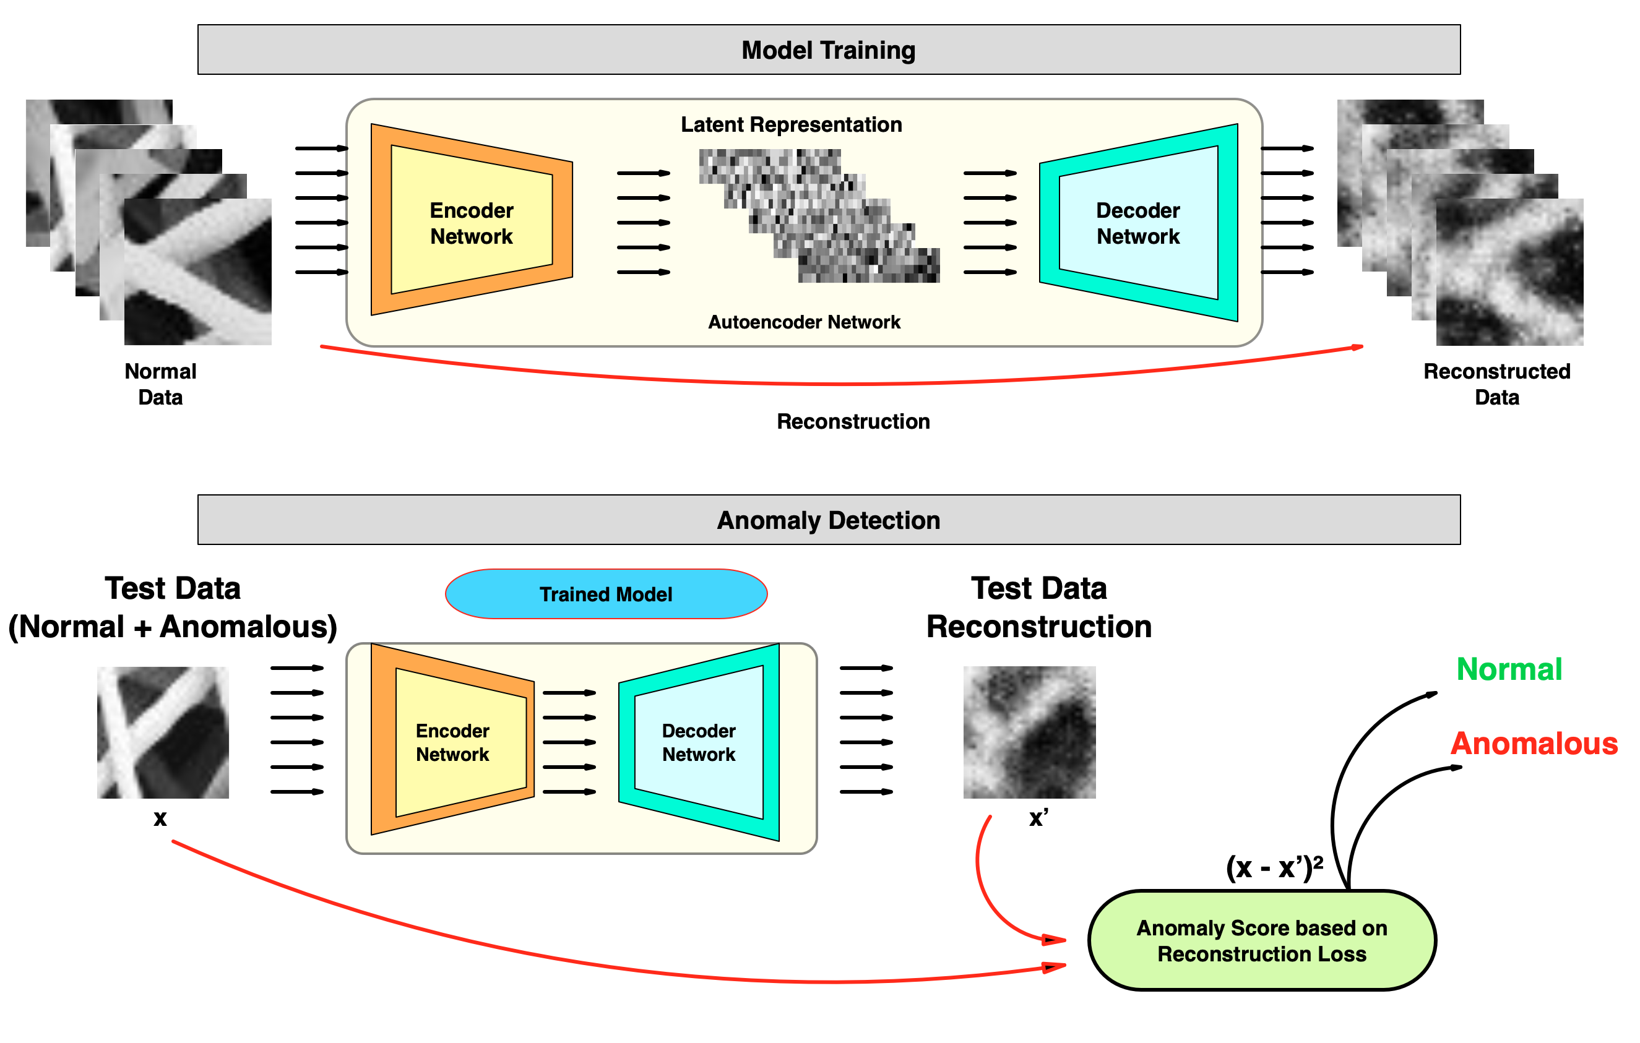
Reconstruction Based Anomaly Detection
6
Master of Science thesis - Şemsi Yiğit Özgümüş
POLITECNICO DI MILANO
Notes:
Anomaly detection is performed by applying the reconstruction operation on a test patch.
Since the model is trained only on the normal data, defined reconstruction difference will be higher with anomalous samples
Anomaly score defined using this reconstruction difference can detect anomalies by comparing the score to a threshold value

Slide 8
Generative Adversarial Networks and Anomaly Detection
POLITECNICO DI MILANO
Notes:
In this thesis we investigate GAN and their utilization in anomaly detection

Slide 9
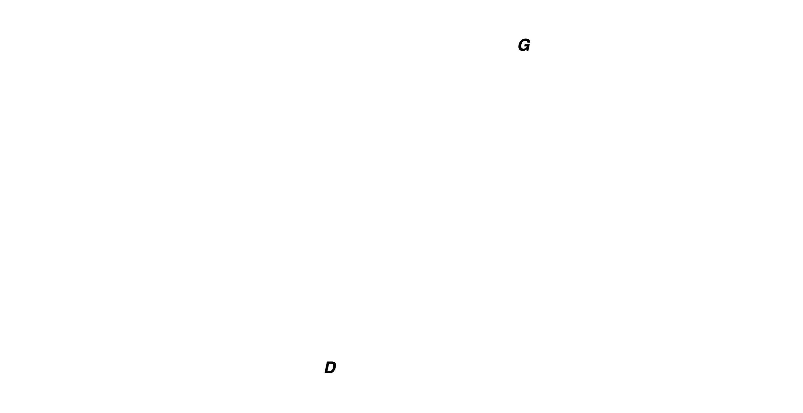
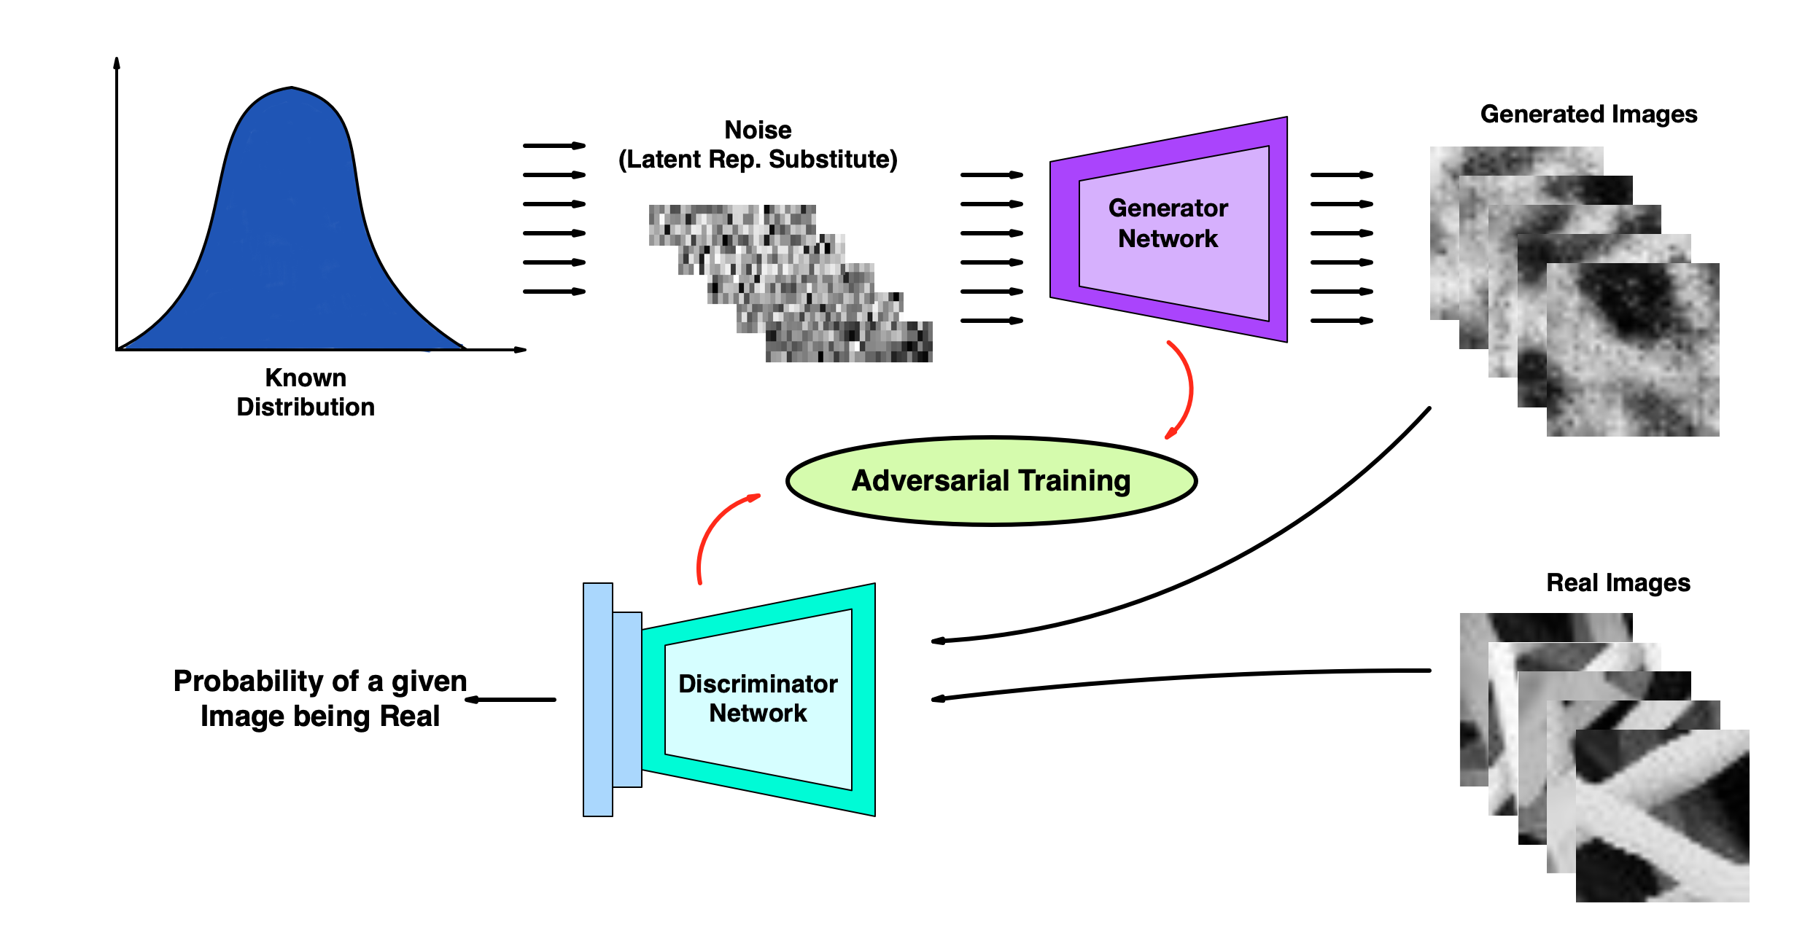
What is Generative Adversarial Network* ?
Network pair trained adversarially using a mini max game
Generator learns the generate data similar to target data’s distribution
Mapping from latent dimension to higher dimension is learned
* Ian J. Goodfellow et al. “Generative Adversarial Nets NIPS’14. Montreal, Canada: MIT Press, 2014
7
Master of Science thesis - Şemsi Yiğit Özgümüş
POLITECNICO DI MILANO
Notes:
Generative adversarial networks are considered as one of the most significant breakthroughs in deep learning and generative modeling in recent years
This framework can generate realistic data similar to given training data
It achieves this by learning the mapping from a known latent noise to the image distribution of training data
using unsupervised training.
Generator learns to create realistic samples by trying to fool the discriminator
Because discriminator is responsible for differentiating the real and the fake images
It outputs the probability of a given image being real.

Slide 10
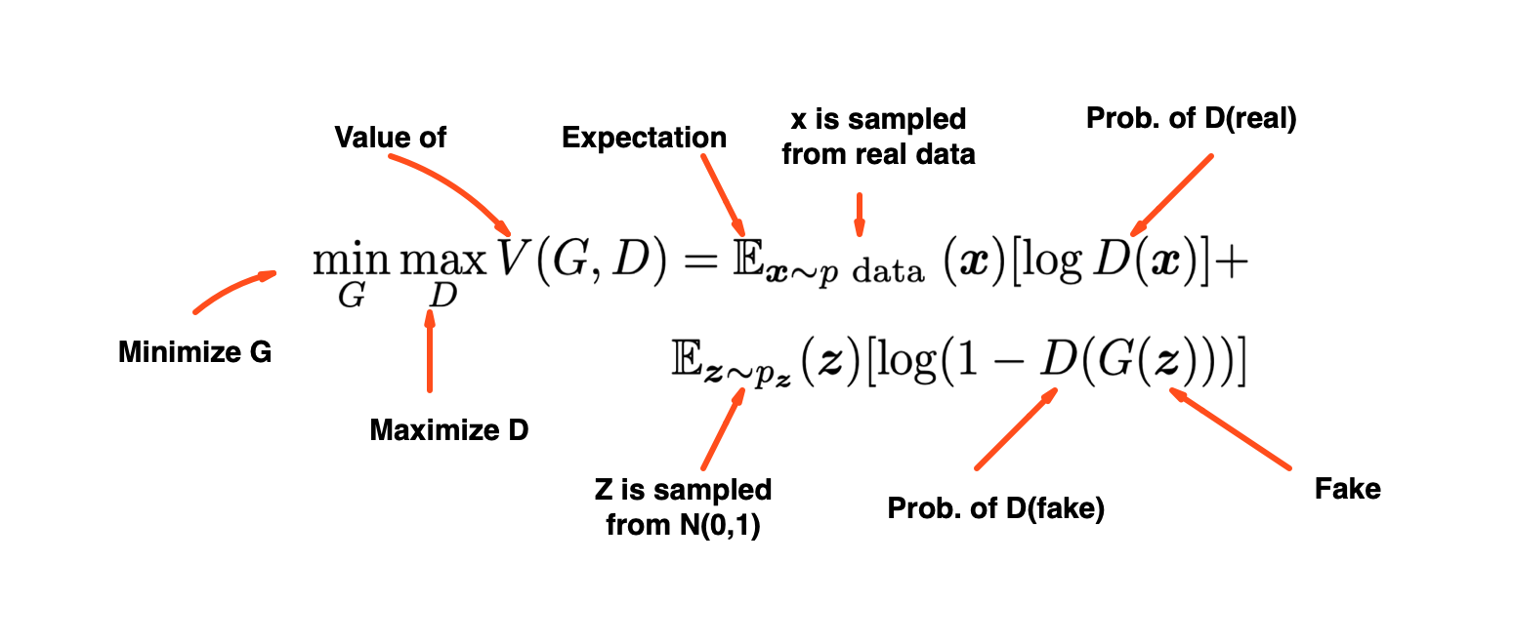
What is Generative Adversarial Network ?
Training objective of GAN:
8
Master of Science thesis - Şemsi Yiğit Özgümüş
POLITECNICO DI MILANO
Notes:
Training objective of the gan is this value function
It is an alternating minimax game played between the two networks
Terms are composed of discriminator’s evaluation of real and generated images

Slide 11
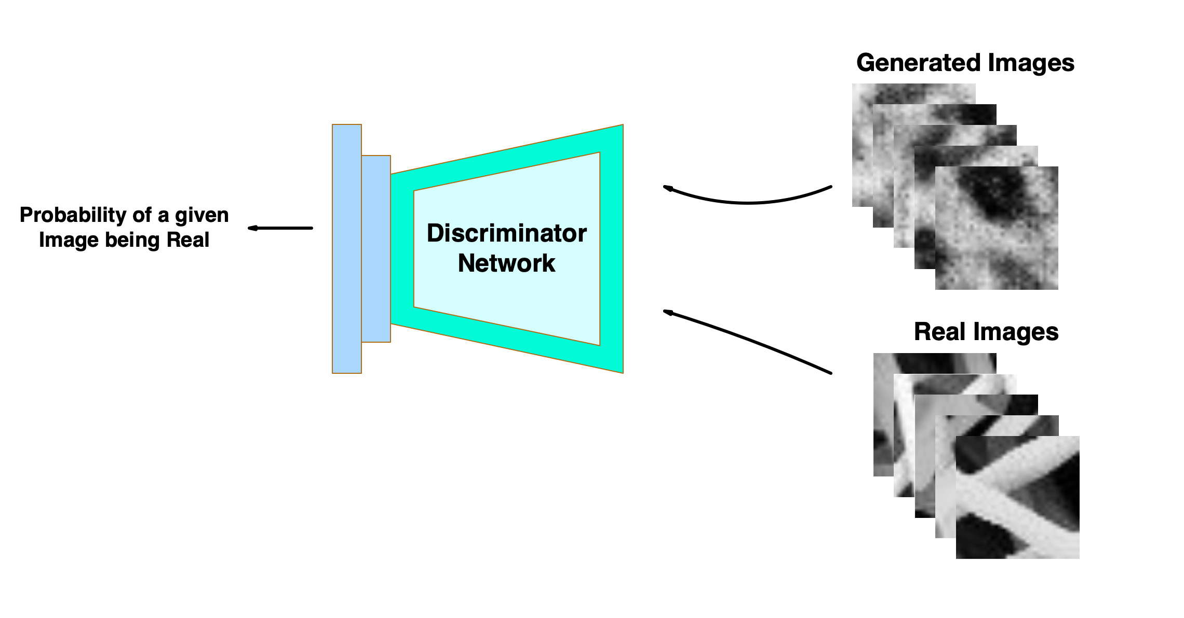
What is Generative Adversarial Network ?
Perspective of Discriminator Network:
Real samples classified as being real
Discriminator wants to maximize this
Generated samples classified as being fake
Discriminator wants to minimize this
9
Master of Science thesis - Şemsi Yiğit Özgümüş
POLITECNICO DI MILANO
Notes:
If we disect this function for individual networks
Discriminator needs to maximize these terms.
As it needs to learn the detect real images as real
And to detect generated images as fake during the training

Slide 12
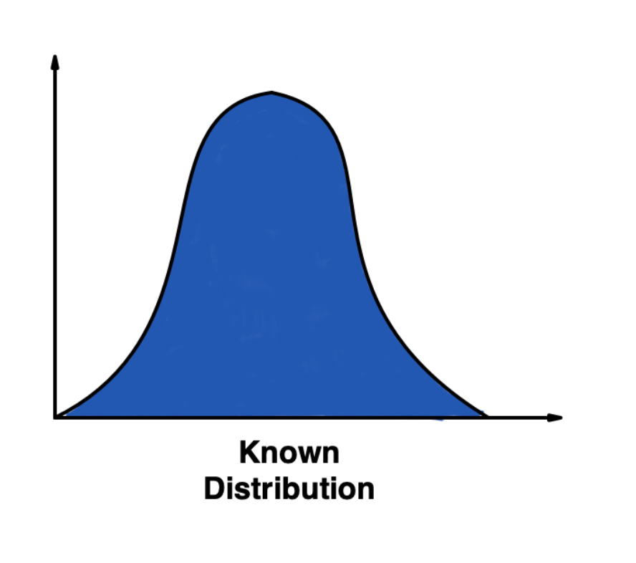
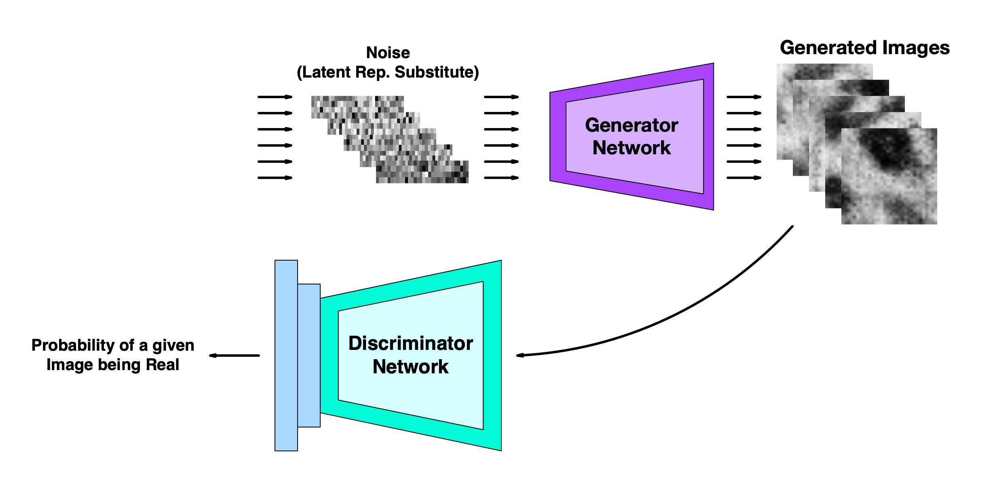
What is Generative Adversarial Network ?
Perspective of Generator Network:
How realistic are the generated samples ?
Generator wants to maximize this
10
Master of Science thesis - Şemsi Yiğit Özgümüş
POLITECNICO DI MILANO
Notes:
Generator interprets this function as how realistic are the generated samples.
It wants to increase the output that discriminator assigns for generated images
So it maximizes the probability output by minimizing the term.

Slide 13
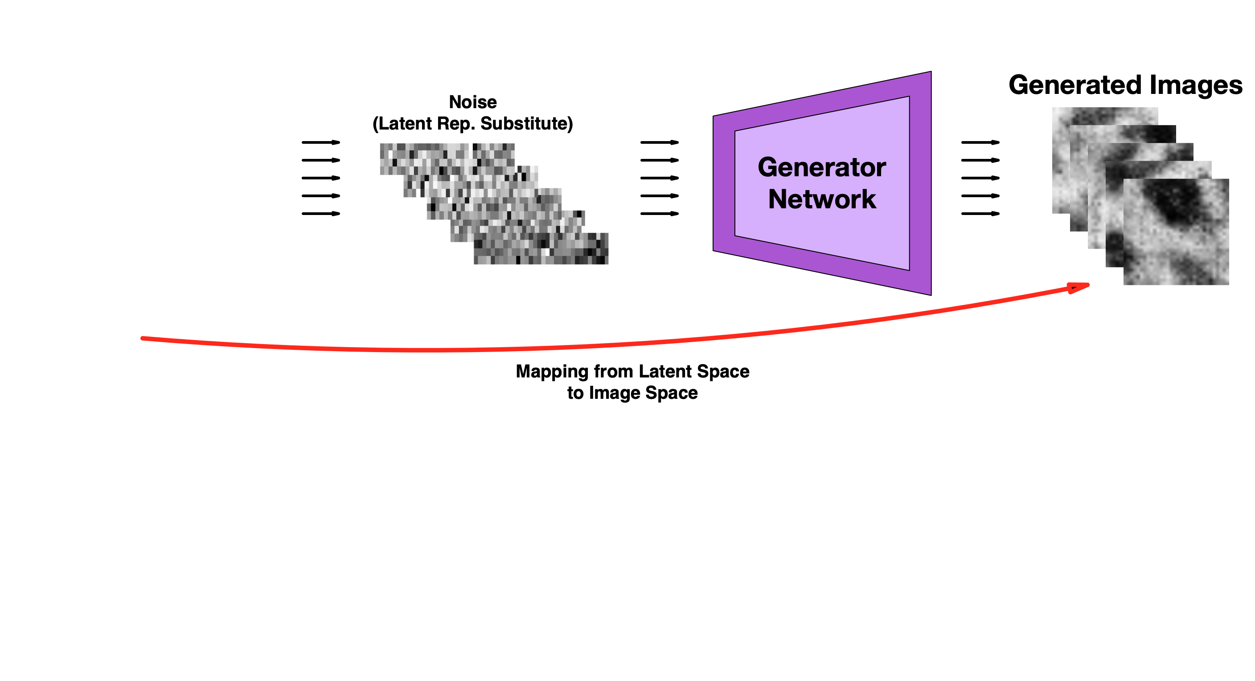
Motivation Behind Using GAN for Anomaly Detection
11
Master of Science thesis - Şemsi Yiğit Özgümüş
POLITECNICO DI MILANO
Notes:
The main motivation behind studying gan for anomaly detection is that, once its trained,
Generator network implicitly learns to map from latent space of a known distribution to image space.
this trained generator can then be used to adversarially learn the inverse mapping,

Slide 14
Motivation Behind Using GAN for Anomaly Detection
12
Master of Science thesis - Şemsi Yiğit Özgümüş
POLITECNICO DI MILANO
Notes:
Like so.
by learning to generate similar images, Then

Slide 15

Motivation Behind Using GAN for Anomaly Detection
12
Master of Science thesis - Şemsi Yiğit Özgümüş
POLITECNICO DI MILANO
Notes:
that is from image space to latent space.
This bidirectional mapping is the same approach utilized in the reconstruction based anomaly detection methods.
This combined mapping provides us a way to use GAN for anomaly detection.

Slide 16
GAN Based Anomaly Detection Models
POLITECNICO DI MILANO
Notes:
Now I would like to give information about GAN based anomaly detection methods in literature

Slide 17
GAN Based Anomaly Detection Models
GAN training + latent representation learning
13
Master of Science thesis - Şemsi Yiğit Özgümüş
POLITECNICO DI MILANO
Notes:
As I’ve just explained, GAN based Anomaly detection comprise of two steps.
Training of GAN and learning latent representation mapping also called inverse mapping.
In literature, there are 2 types of approaches that combine these steps.

Slide 18
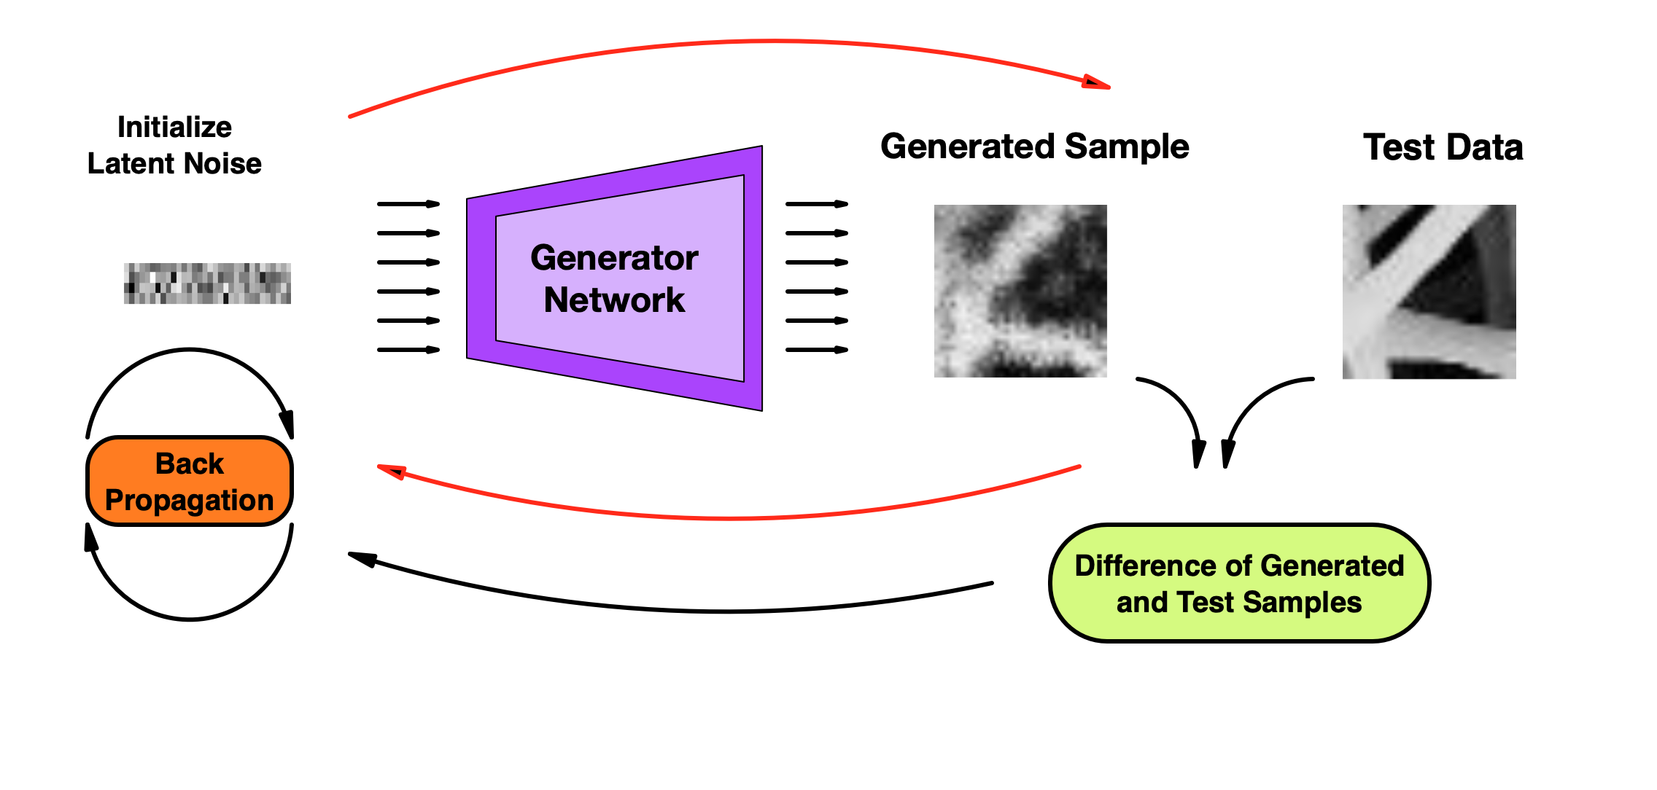
GAN Based Anomaly Detection Models
GAN training + latent representation learning
AnoGAN* → Learning inverse mapping with optimization problem
Slow testing performance
* Thomas Schlegl et al. “Unsupervised Anomaly Detection with Gen- erative Adversarial Networks to Guide Marker Discovery”. In: IPMI. 2017.
14
Master of Science thesis - Şemsi Yiğit Özgümüş
POLITECNICO DI MILANO
Notes:
First type learns the inverse mapping with an optimization problem
Anogan Model performs classic GAN training during the training stage.
At the test stage, it uses trained generator to perform back propagation to approximate the latent representation for each given patch.
Drawback of this method is that considering an image can consist of hundreds maybe thousands of patches
Anomaly detection on a image becomes a really slow operation and not suitable for real time anomaly detection.

Slide 19
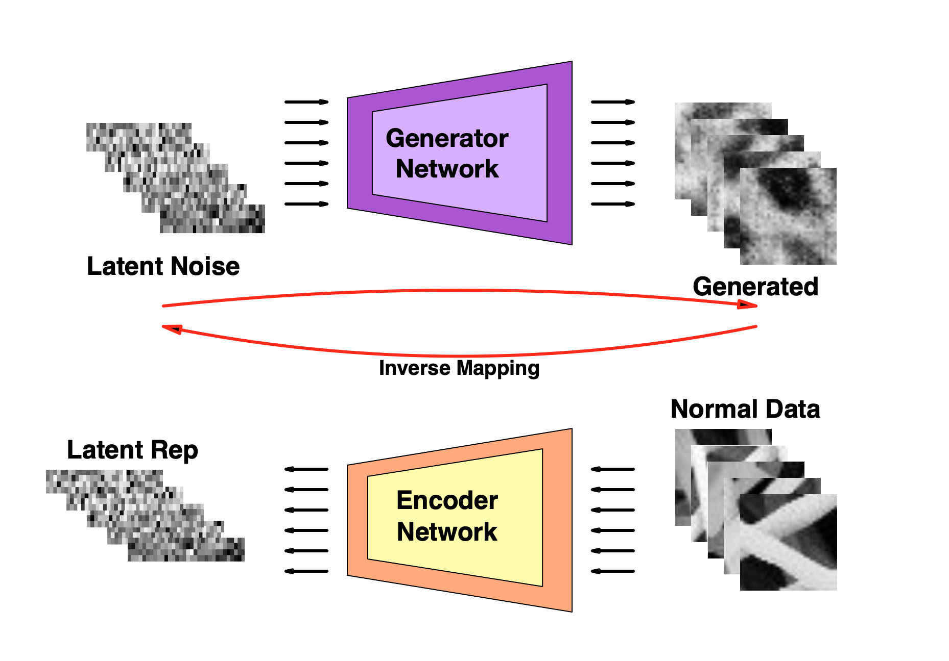
GAN Based Anomaly Detection Models
GAN training + latent representation learning
AnoGAN → Learning inverse mapping with optimization problem
BiGAN¹, ALAD² → Adversarial feature learning using Encoder network
Convergence & Stabilization problems
1 -Jeff Donahue, Philipp Krähenbühl, and Trevor Darrell. “Adversarial Feature Learning”. In: CoRR abs/1605.09782 (2017).
2 - Houssam Zenati et al. “Adversarially Learned Anomaly Detection”. In: CoRR abs/1812.02288 (2018). arXiv: 1812.02288. url: http: //arxiv.org/abs/1812.02288.
15
Master of Science thesis - Şemsi Yiğit Özgümüş
POLITECNICO DI MILANO
Notes:
Another approach is to learn the inverse mapping using an encoder network.
BiGAN and ALAD models include encoder to the adversarial training stage
Encoder is trained to learn the mapping from image space to latent space as generator learns the inverse.
Main disadvantage is that including encoder to the adversarial training can cause stabilization and convergence problems which consequently affects the reconstruction quality
Our implementations of these models didn’t manage to learn dataset well enough to obtain a good reconstruction.

Slide 20
Proposed Model (SENCEBGAN)
POLITECNICO DI MILANO
Notes:
Considering these problems, we propose an improved model

Slide 21
Proposed Model
Energy Based GAN for more stable training
Encoder networks for latent representations of inputs and their reconstructions.
Separate training to ensure convergence
16
Master of Science thesis - Şemsi Yiğit Özgümüş
POLITECNICO DI MILANO
Notes:
That consist of a different GAN architecture to provide more stable training.
And 2 separate encoder networks to learn the latent representation of both image and its reconstruction.
Model trains these encoders separately to mitigate the convergence problems of the networks

Slide 22
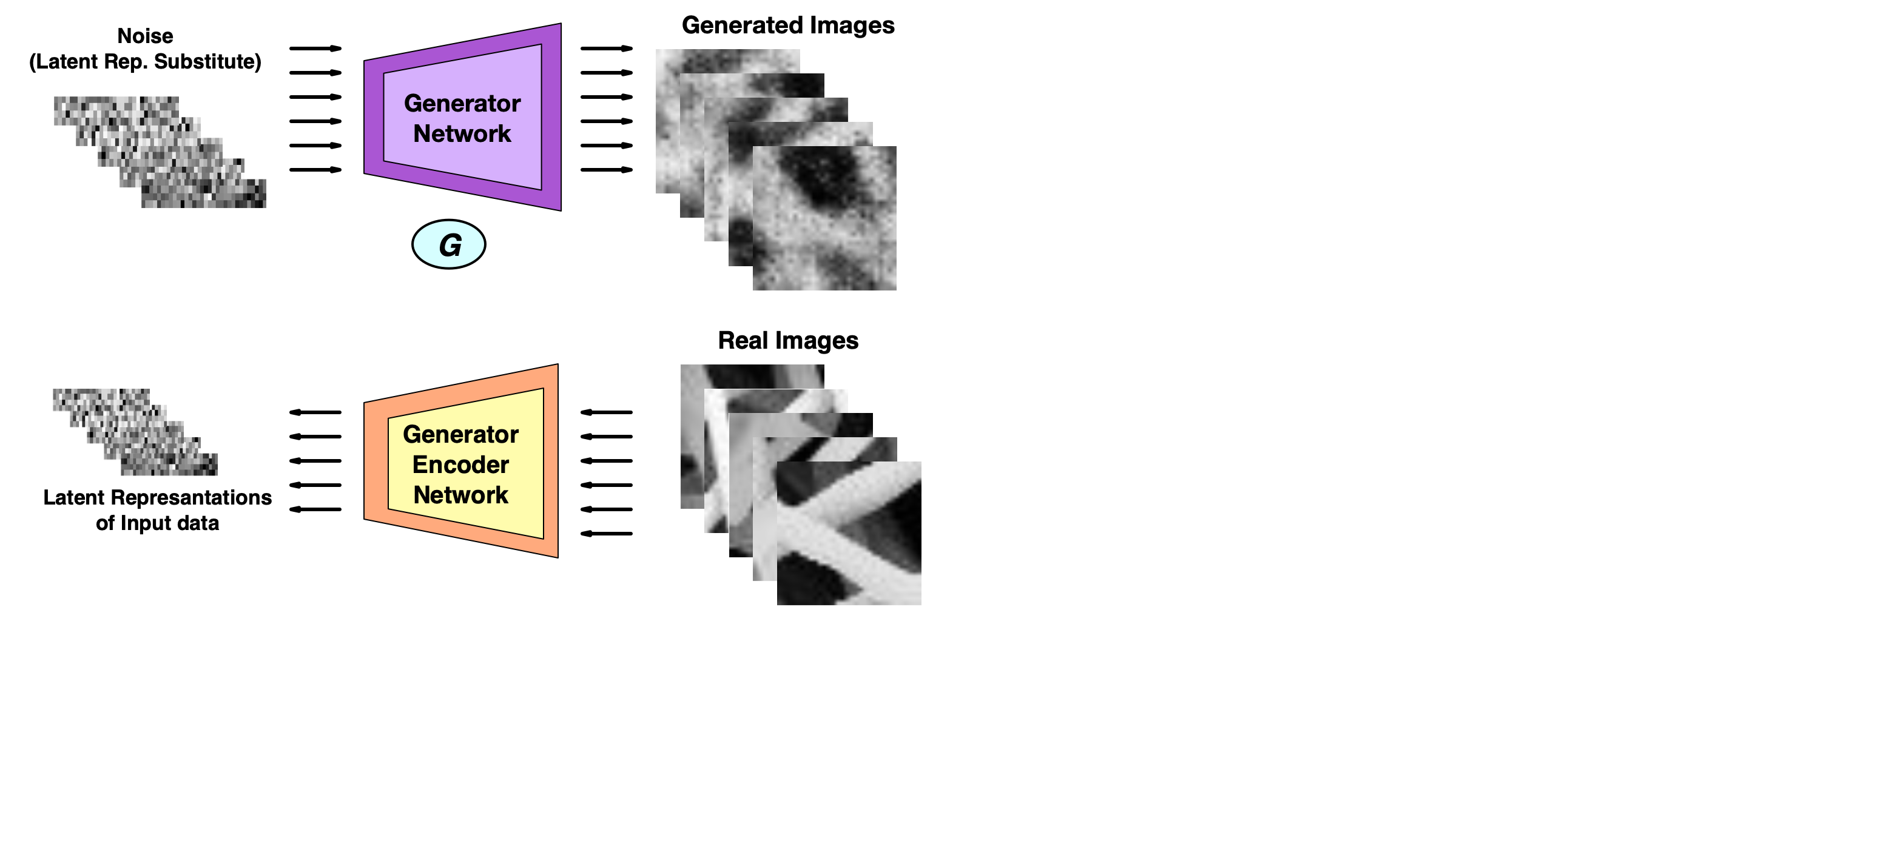
Proposed Model
Energy Based GAN for more stable training
Encoder networks for latent representations of inputs and their reconstructions.
Sequential training to ensure convergence
17
Master of Science thesis - Şemsi Yiğit Özgümüş
POLITECNICO DI MILANO
Notes:
Generator and primary encoder network in our model learns bi-directional mapping adversarially like in BiGAN and ALAD

Slide 23
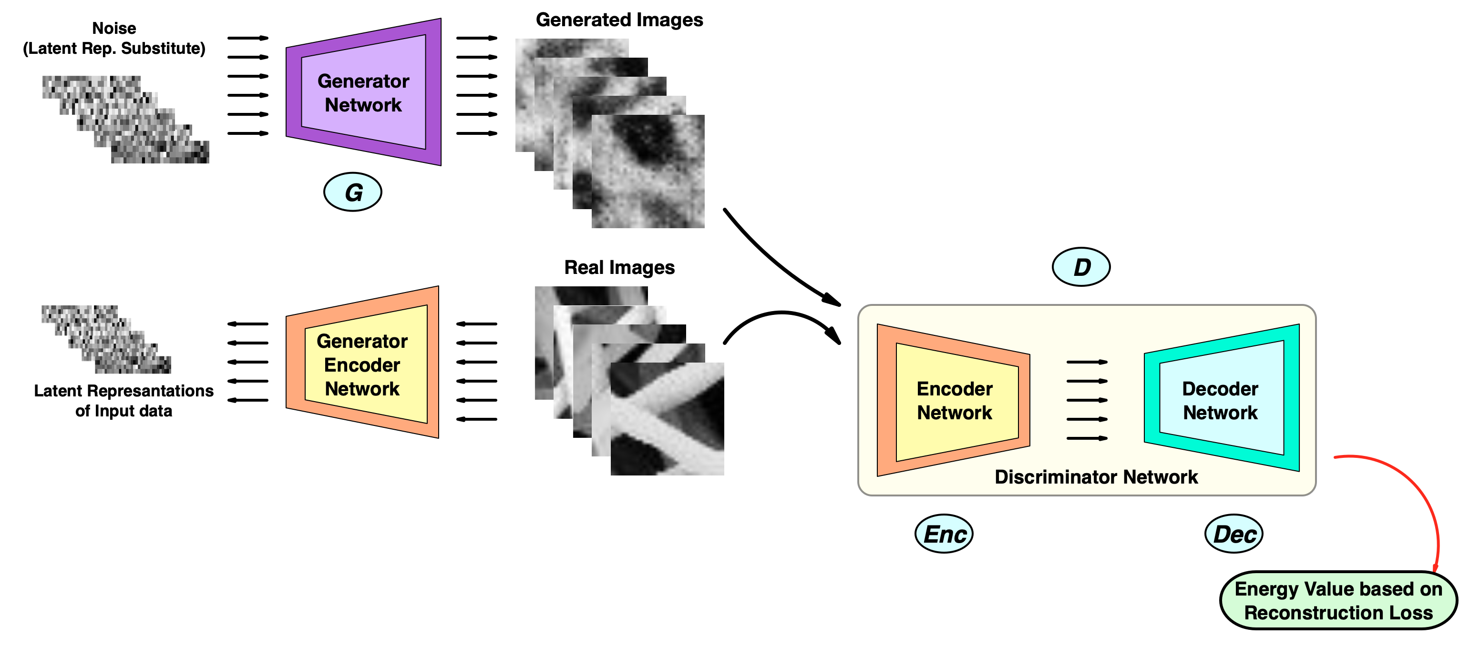
Proposed Model
Energy Based GAN for more stable training
Encoder networks for latent representations of inputs and their reconstructions.
Sequential training to ensure convergence
18
Master of Science thesis - Şemsi Yiğit Özgümüş
POLITECNICO DI MILANO
Notes:
They are trained using a discriminator network that consists of an autoencoder network.

Slide 24
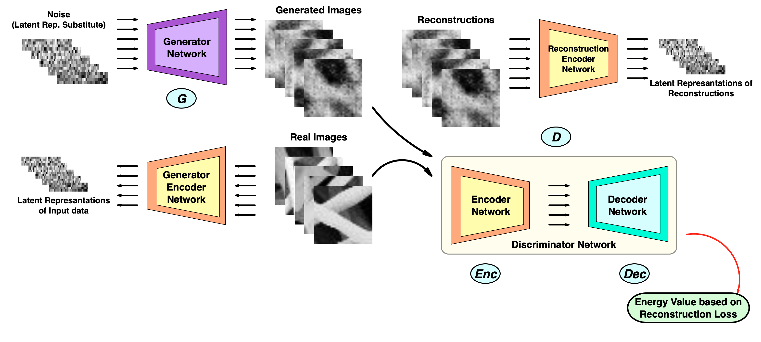
Proposed Model
Energy Based GAN for more stable training
Encoder networks for latent representations of inputs and their reconstructions.
Sequential training to ensure convergence
19
Master of Science thesis - Şemsi Yiğit Özgümüş
POLITECNICO DI MILANO
Notes:
Secondary encoder network is trained to learn the latent representation of the image reconstructions.

Slide 25
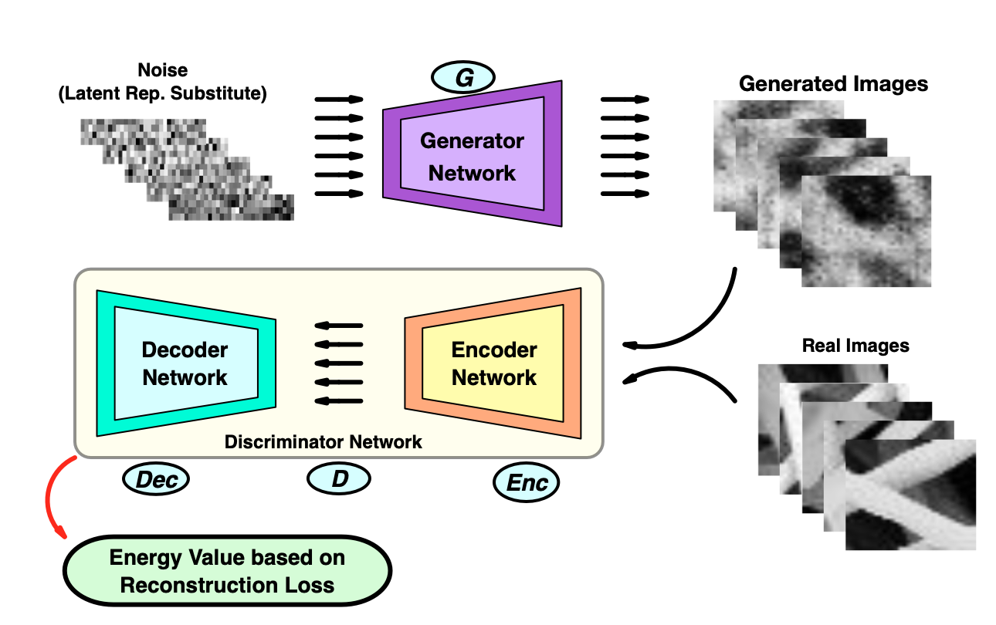
Energy Based Generative Adversarial Network*
Discriminator Network becomes autoencoder network
Energy is the Reconstruction error
* Junbo Jake Zhao, Michaël Mathieu, and Yann LeCun. “Energy-based Generative Adversarial Network”. In: CoRR abs/1609.03126 (2016).
20
Master of Science thesis - Şemsi Yiğit Özgümüş
POLITECNICO DI MILANO
Notes:
First part of the model , energy based GAN is used to train the framework in a more stable way by defining the image space as an energy region.
Discriminator is modeled as autoencoder It computes and energy score using its internal reconstruction function.
According to this new adversarial setting, normal images outputs a lower energy while generated data outputs a higher energy score.

Slide 26
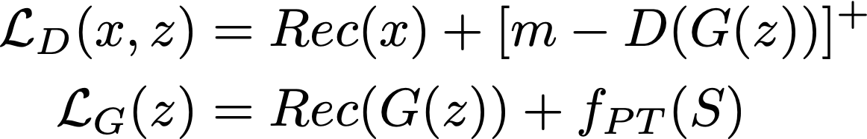
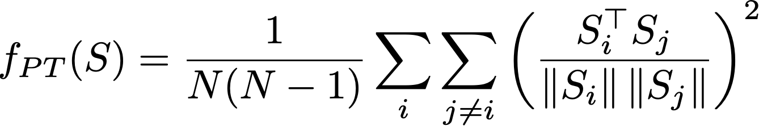
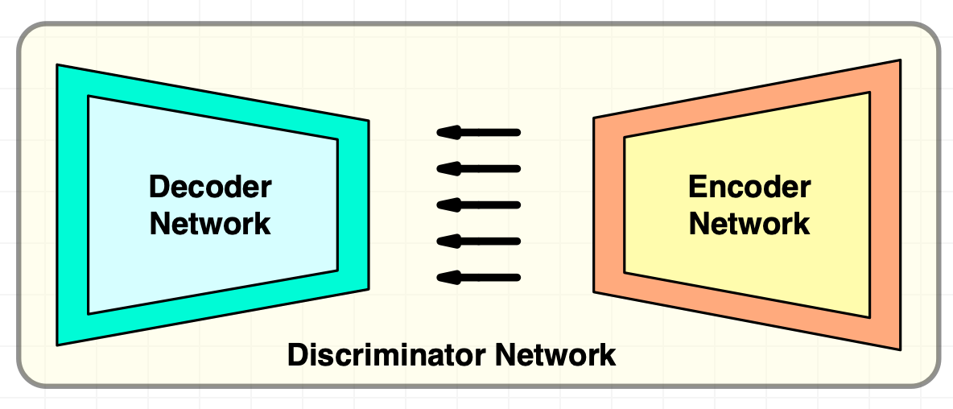
Adversarial Training of EBGAN
All loss functions trained to be minimized
Energy based value function based on margin loss
Margin m defines a higher energy band for generated images
Pulling away term helps generator to diversify the generated samples
Latent representation pair S
21
Master of Science thesis - Şemsi Yiğit Özgümüş
POLITECNICO DI MILANO
Notes:
For the adversarial training, discriminator needs to minimize the terms it assigns to real and fake images for its loss
Margin value m defines a higher energy band for fake images so discriminator maximizes the energy score for fake images by minimizing the term.
Generator is trained to generate samples that discriminator assigns low energy.
Additional pull away loss f_pt is also added to the training.
It uses cosine similarity between pairs of latent reps from discriminator to penalize the generator
in case the generated samples becomes too similar.
This helps generator to learn to generate more diverse samples

Slide 27
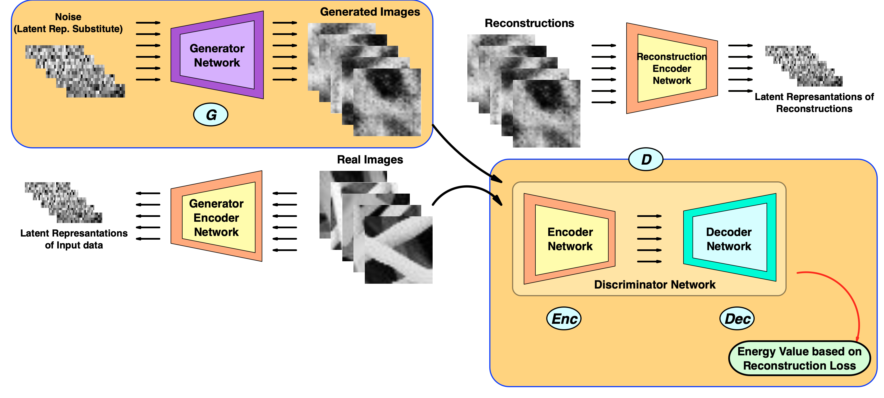
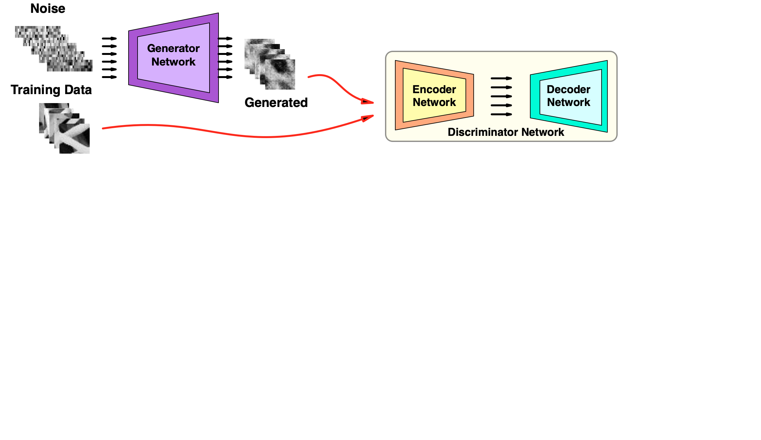
Training of the Model – Stage 1
Initial stage is energy based GAN training
22
Master of Science thesis - Şemsi Yiğit Özgümüş
POLITECNICO DI MILANO
Notes:
Training of the model is performed separately and composed of three stages,
In first stage the energy based GAN is trained and it learns the mapping between the latent space to image space

Slide 28
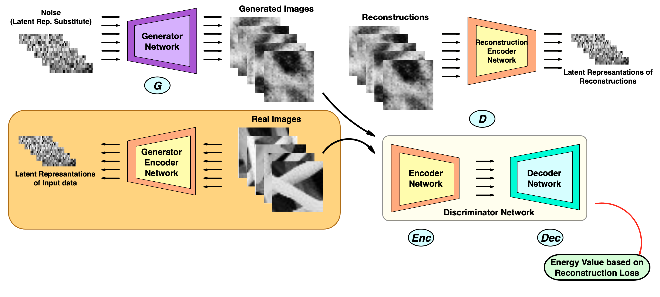
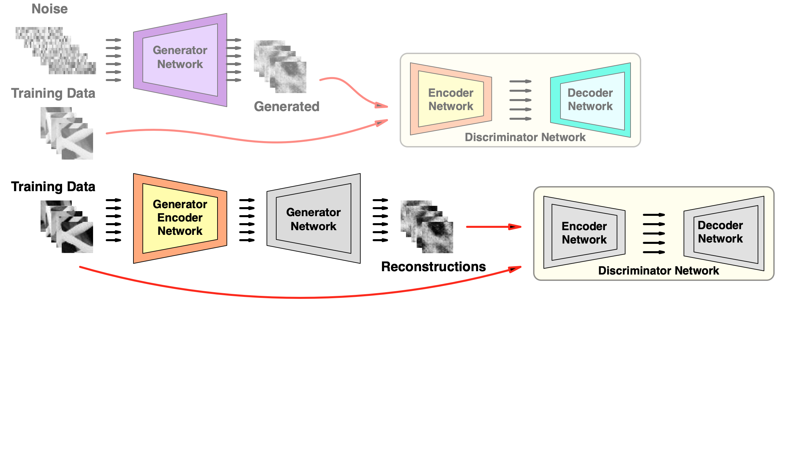
Training of the Model – Stage 2
Generator Encoder training for bi directional mapping
23
Master of Science thesis - Şemsi Yiğit Özgümüş
POLITECNICO DI MILANO
Notes:
In second stage, generator encoder network adversarially learns to map from image space to latent space

Slide 29
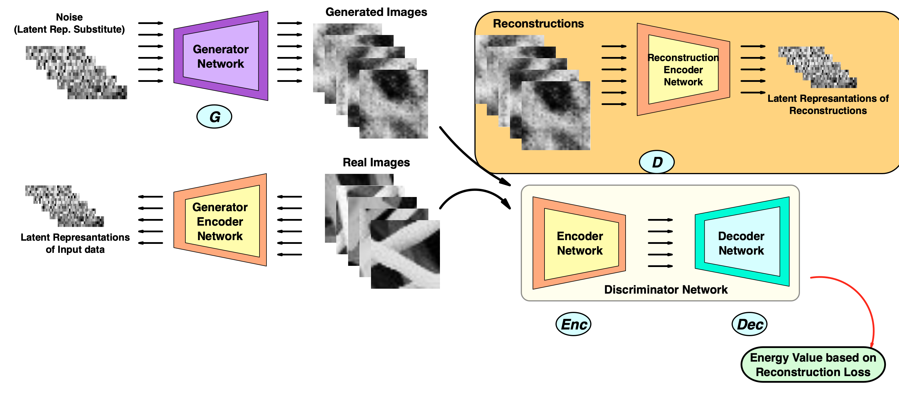
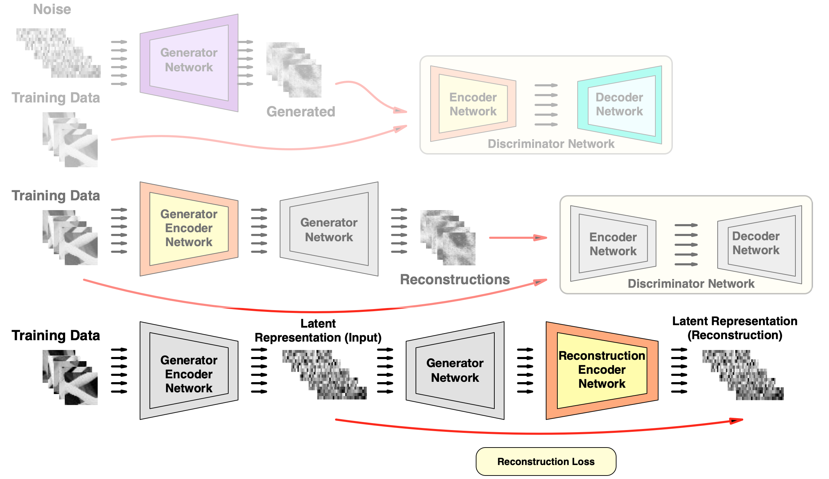
Training of the Model – Stage 3
Reconstruction Encoder training for L.R. of reconstructions
24
Master of Science thesis - Şemsi Yiğit Özgümüş
POLITECNICO DI MILANO
Notes:
In the final stage, the latent representation of the reconstructions are learned. We observe that

Slide 30
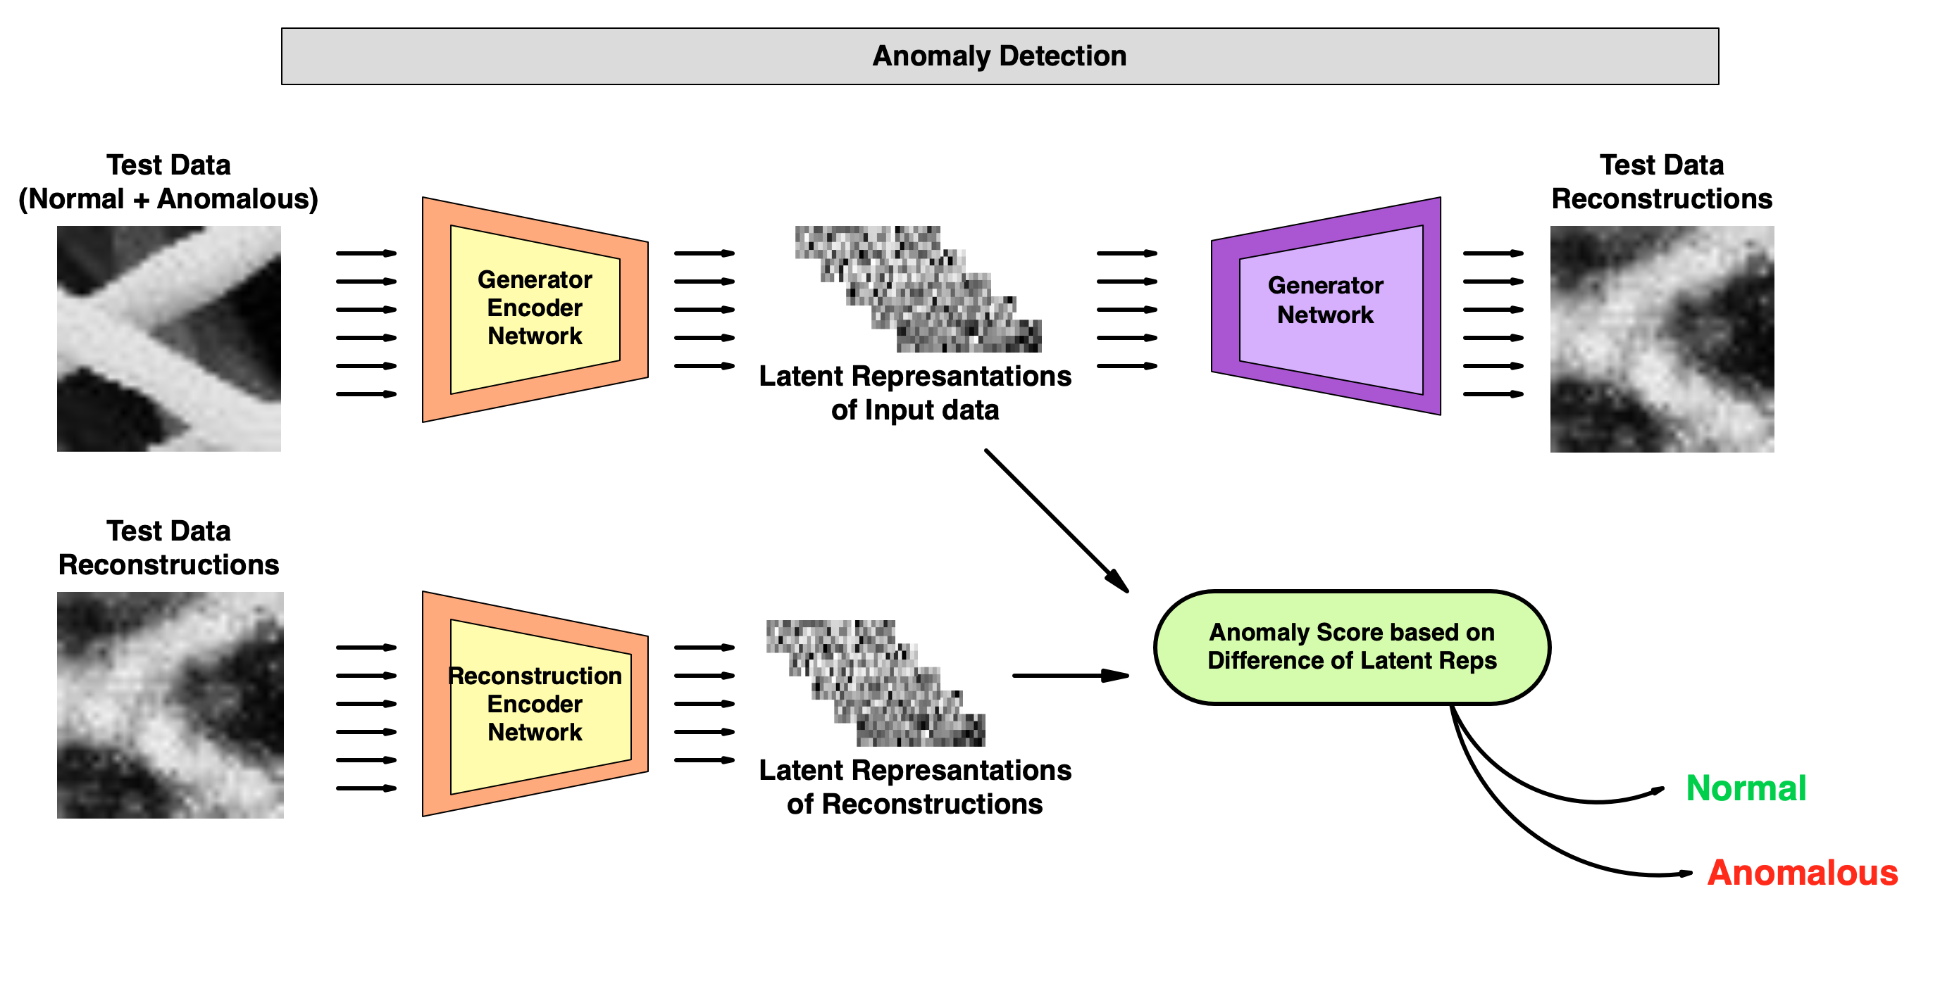
Anomaly Detection of Proposed Model ( SENCEBGAN)
25
Master of Science thesis - Şemsi Yiğit Özgümüş
POLITECNICO DI MILANO
Notes:
Anomaly score computation based on the latent representation rather than the image and its reconstruction provides a more reliable distinction for this problem
And our experiments show that using this anomaly score computation provide us an improved performance

Slide 31
Experiments & Results
POLITECNICO DI MILANO
Notes:
Now I will present our experiment results

Slide 32
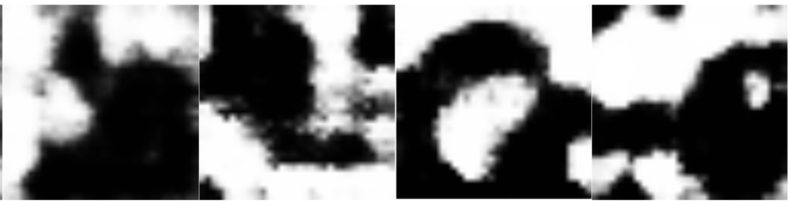
Generator Image Generation Comparison
Generated samples from AnoGAN, BiGAN and ALAD
26
Master of Science thesis - Şemsi Yiğit Özgümüş
POLITECNICO DI MILANO
Notes:
All models used in these experiments are implemented from scratch and tested with our dataset
First results compares the generator capacity of the models
These samples show the outputs of generator networks of the models after the gan training.
Generated images does not resemble our training data due to stabilization issues

Slide 33
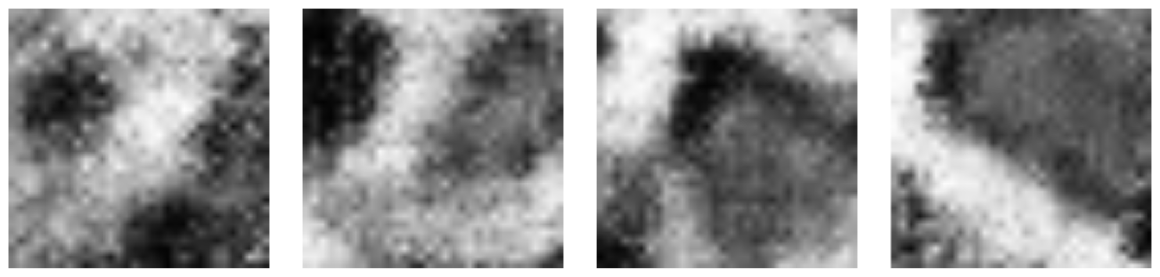
Generator Image Generation Comparison
Generated samples from AnoGAN, BiGAN and ALAD
Generated samples from proposed model (SENCEBGAN)
27
Master of Science thesis - Şemsi Yiğit Özgümüş
POLITECNICO DI MILANO
Notes:
These are the generation results of energy based GAN of our model. Our model presents more visually similar image generations

Slide 34
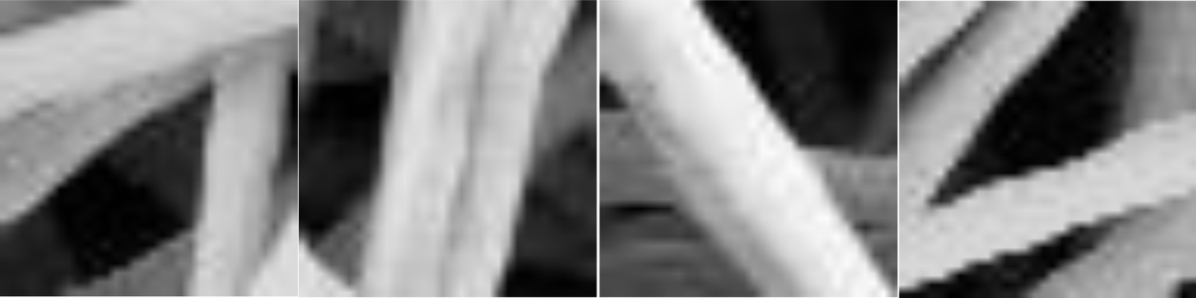
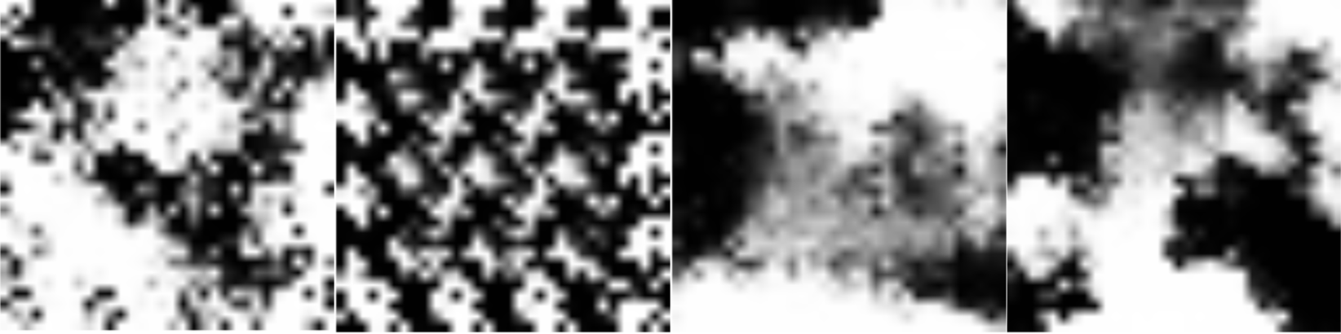
Reconstruction Quality Comparison
Reconstruction samples from AnoGAN, BiGAN and ALAD
28
Master of Science thesis - Şemsi Yiğit Özgümüş
POLITECNICO DI MILANO
Notes:
Next we compare the reconstruction quality of the models
These are the results from the models in literature

Slide 35
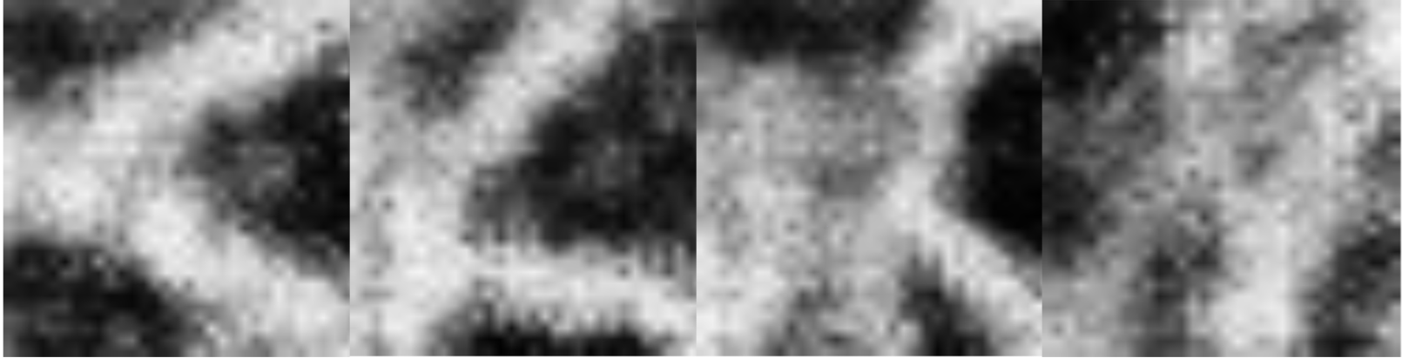
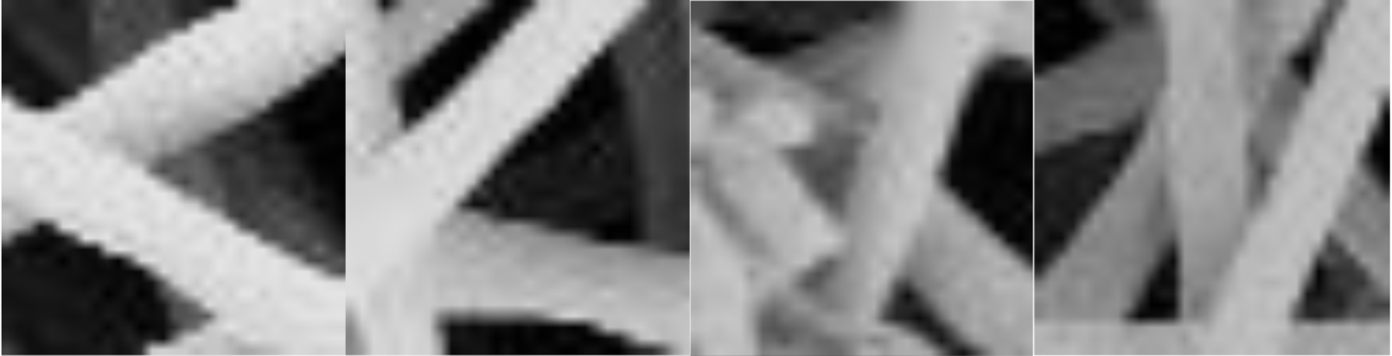
Reconstruction Quality Comparison
Reconstruction samples from AnoGAN, BiGAN and ALAD
Reconstruction samples from proposed model (SENCEBGAN)
29
Master of Science thesis - Şemsi Yiğit Özgümüş
POLITECNICO DI MILANO
Notes:
And these are the reconstruction samples from our model
One can observe that generator quality directly affects the reconstruction quality.

Slide 36
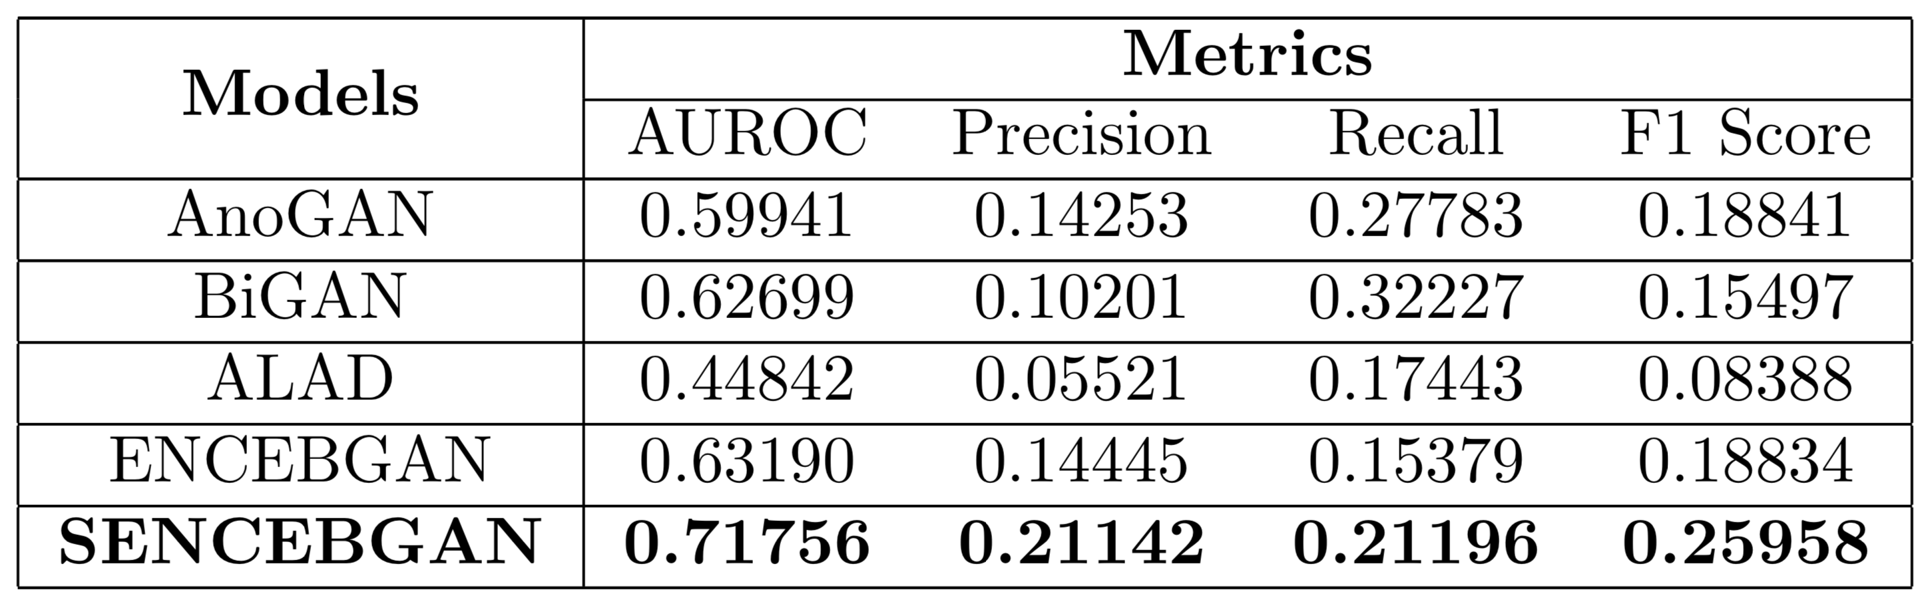
Performance Comparison
ENCEBGAN : Second encoder not trained, anomaly score based on image and reconstruction
SENCEBGAN : Latent representation based anomaly score
30
Master of Science thesis - Şemsi Yiğit Özgümüş
POLITECNICO DI MILANO
Notes:
This table shows the overall performance of the models
Anomaly score based on image data is also tested with ENCEBGAN model
Overall our model marginally improved the performance on anomaly detection and considerably improved visual quality of reconstructions

Slide 37
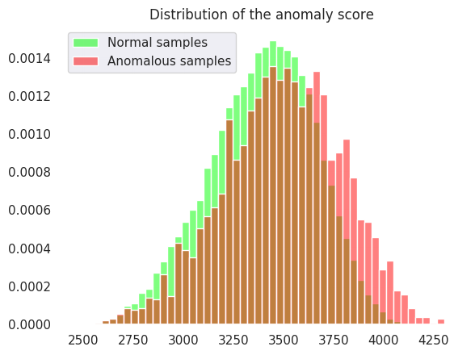
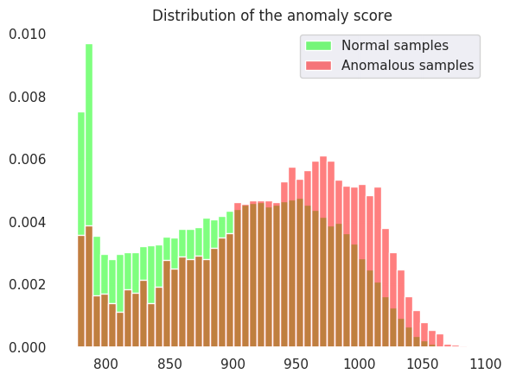
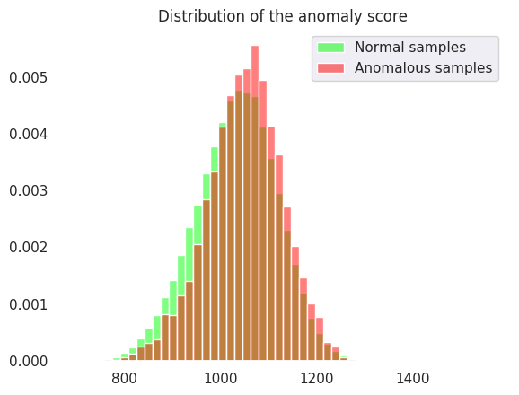
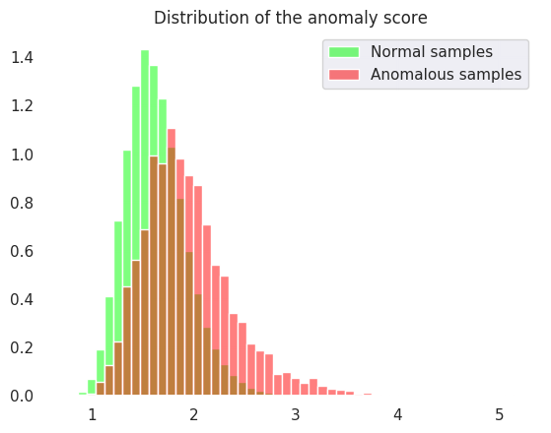
Seperation of Anomalies
AnoGAN
BiGAN
ALAD
Proposed Model
31
Master of Science thesis - Şemsi Yiğit Özgümüş
POLITECNICO DI MILANO
Notes:
These histograms shows the separation of normal and anomalous patches w.r.t to their assigned anomaly score.

Slide 38
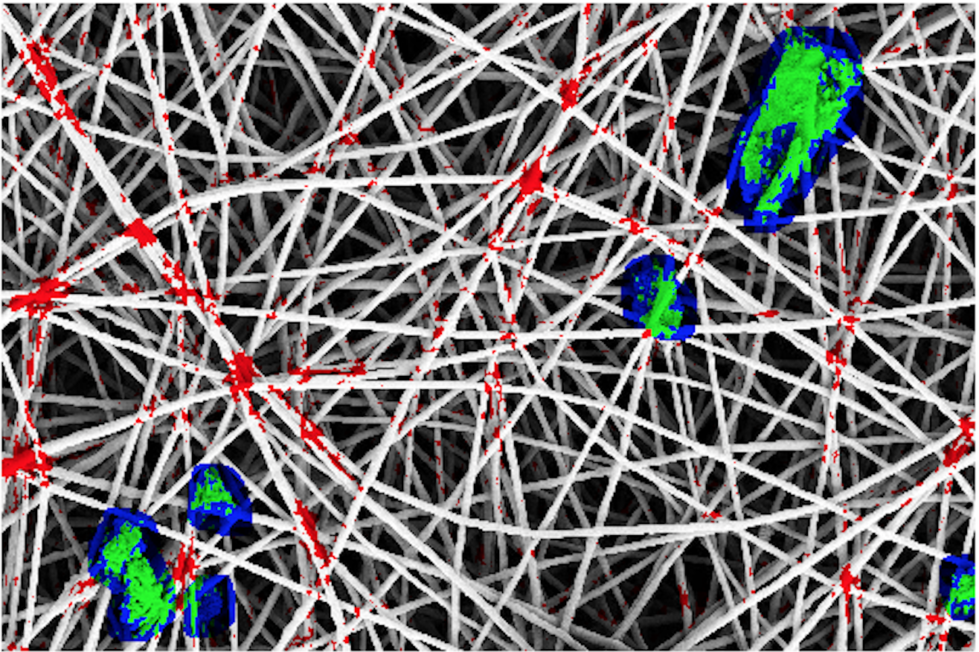
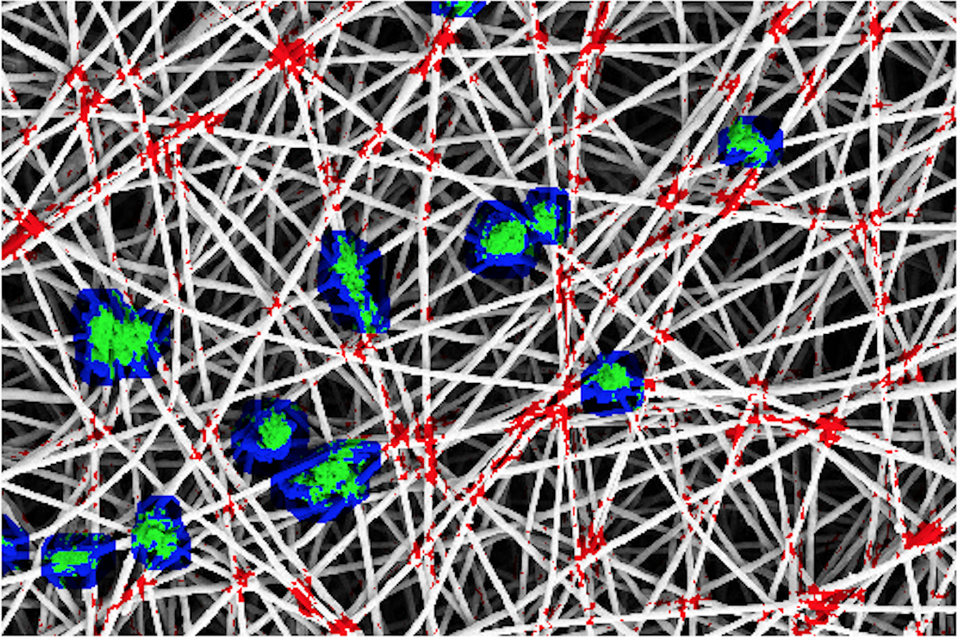
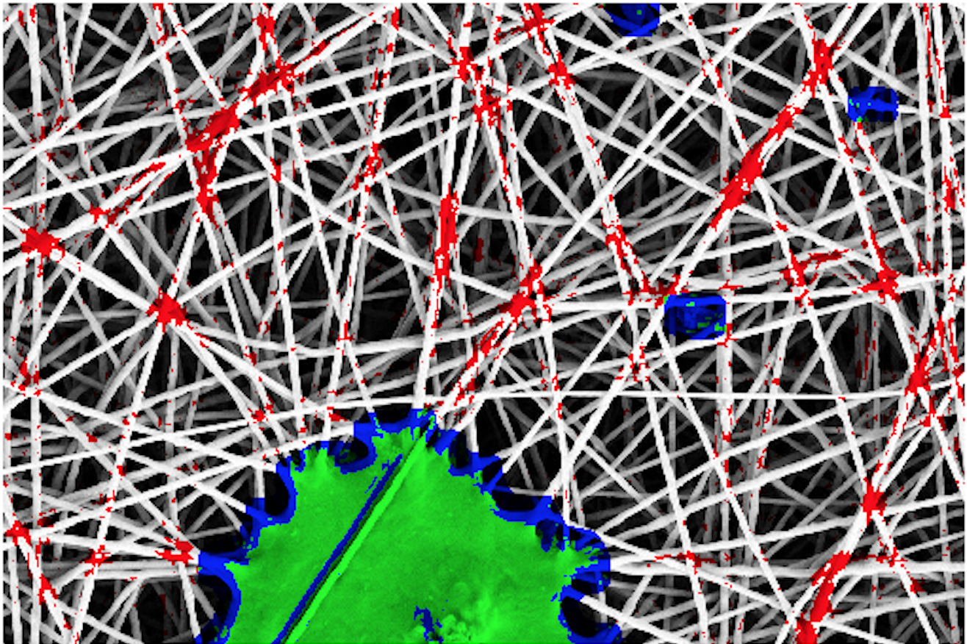
Pixelwise Anomaly Detection Results
True Positives
False Negatives
False Positives
32
Master of Science thesis - Şemsi Yiğit Özgümüş
POLITECNICO DI MILANO
Notes:
Lastly, These are the results of our anomaly detection method on test images with pixelwise coloring.

Slide 39
Conclusions
In conclusion,
We propose a model to address the anomaly detection problem in nanofibrous material production
GAN based anomaly detection shows a promise
Reconstruction quality is the key
Improving feature learning and reconstruction quality for future work
33
Master of Science thesis - Şemsi Yiğit Özgümüş
POLITECNICO DI MILANO
Notes:
In conclusion
In this thesis, we proposed a model to address the anomaly detection problem in nanofibrous material production.
We observe that GAN based anomaly detection shows a promise for this type of problem
Also, reconstruction quality of the GAN is the main factor that affects the performance
We speculate that Improving feature learning of the model by improving the generation quality of the GAN will prove to be more affective solution in the future

Slide 40
Thank you for your attention,
Questions ?
34
POLITECNICO DI MILANO

